Slide 1
Automated Performance Analysis with Caliper, SPOT, and Hatchet
Tutorial Introduction
April 12, 2021
David Boehme
Stephanie Brink
Matt LeGendre
Olga Pearce

Slide 2
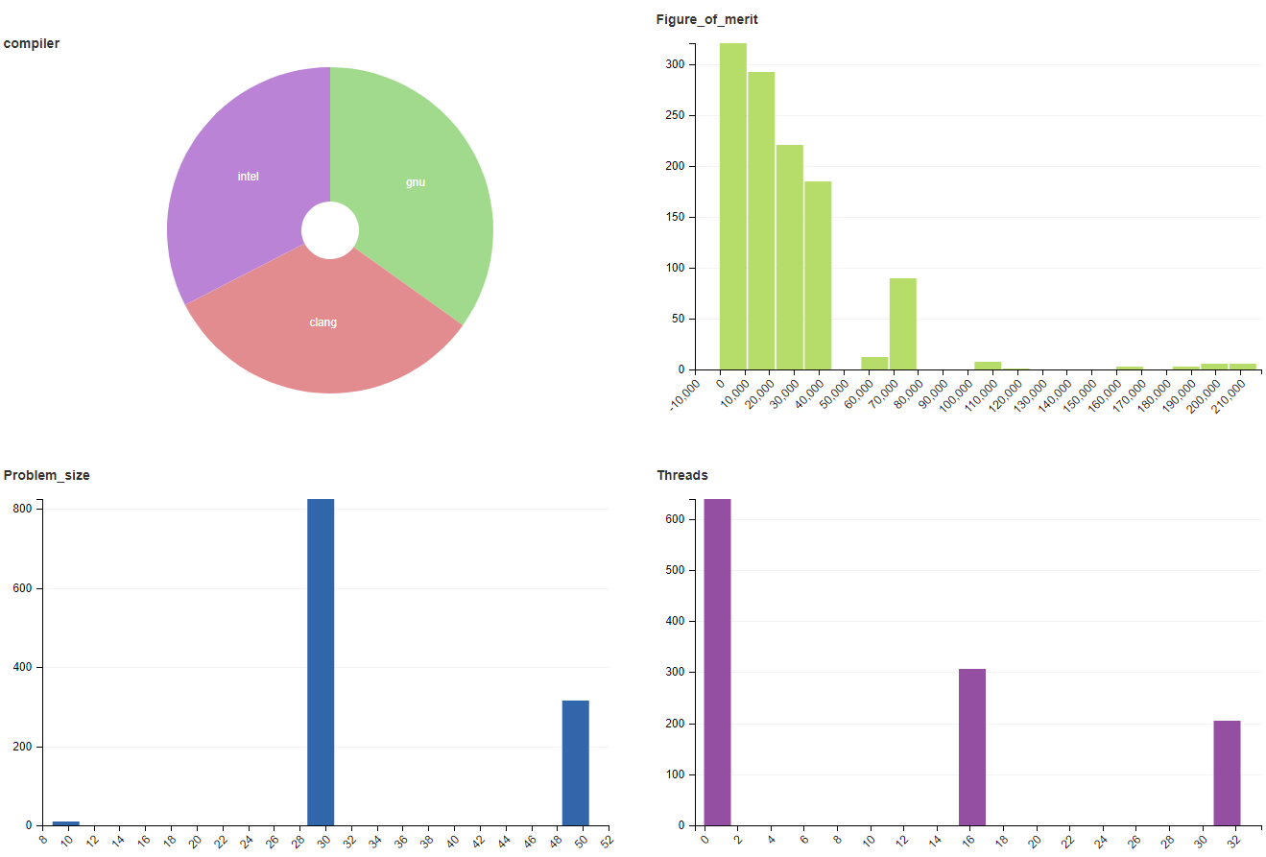

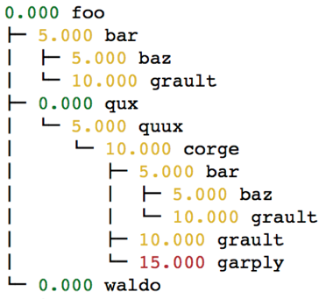
Building Automated Performance Analysis Workflows
Enabling performance analysis as a routine, cumulative activity for HPC software development
#include <caliper/cali.h>
void LagrangeElements(Domain& domain, Index_t numElem)
{
CALI_CXX_MARK_FUNCTION;
// ...
SPOT: Analysis of large collections of runs
Caliper: Instrumentation and Profiling
Hatchet: Call graph analysis in Python
Notes:
This tutorial covers three tools - Caliper, SPOT, Hatchet - that allow you to set up automated performance analysis workflows for HPC software projects
There are many great profiling tools out there that help find performance bottlenecks - but these are geared toward interactive performance debugging and therefore applied retroactively and infrequently
We find it valuable to conduct performance analysis as a routine activity during software development
Our three tools enable “ubiquitous performance analysis” approach that allow you to do anything from running performance tests as part of nightly unit testing up to collecting performance data for every program run
Several large codes at LLNL now use this approach in production
Our tools are Caliper - instrumentation and profiling library; SPOT, a web framework for visualizing and analyzing large collections of runs; and Hatchet, a python library for call-graph analysis
Typical scenario is performance regression testing - instrument and run test code with Caliper, use SPOT to track performance over time; develop custom analysis scripts with Hatchet

Slide 3
Tutorial Outline
Time (ET) |  | Presenter
2:35 - 3:30 | The Caliper Performance Profiling Library | David Boehme, LLNL
3:30 - 3:45 | 15-minute Break
3:45 - 4:45 | Analyzing Large Collections of runs in SPOT (with hands-on exercises) | Matt LeGendre, LLNL
4:45 - 5:00 | 15-minute Break
5:00 - 6:00 | Call-graph Analysis with the Hatchet Python Library (with hands-on exercises) | Olga Pearce, LLNL
Notes:
We cover each tool in about one hour each, with 15-minute breaks between
I start with the Caliper profiling library and how to collect data for automated analysis

Slide 4
AWS Cloud Instances for SPOT and Hatchet Hands-On
Sign up in Google Doc to access AWS instances for SPOT and Hatchet hands-on exercises:
https://docs.google.com/document/d/1DIJH7y4nNvW4zLnAb7mBb5RK5bL6j6FzfFhP-8pvjpI/edit
(Link posted in Chat)

Slide 5
Links
Caliper: https://github.com/LLNL/Caliper
Caliper Documentation: https://llnl.github.io/Caliper
Hatchet: https://github.com/hatchet/hatchet
Hatchet Documentation: https://hatchet.readthedocs.io
SPOT: https://github.com/LLNL/spot2_container

